Slide 1
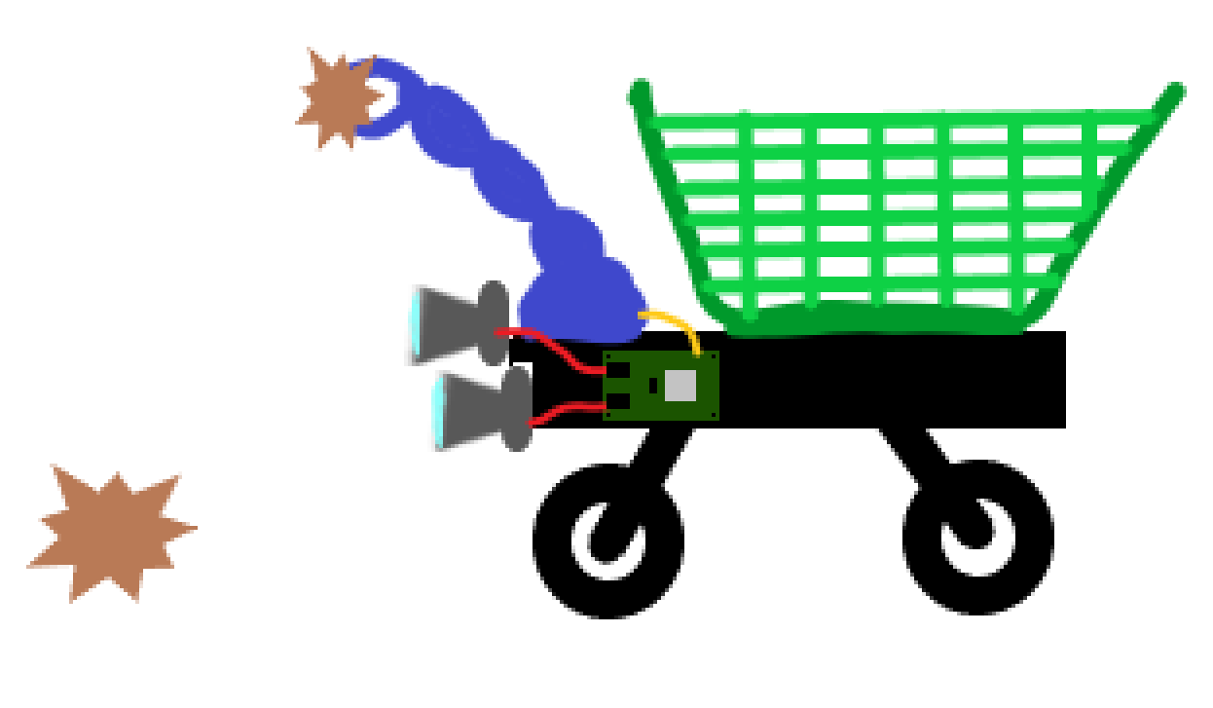
Stereo Visual odometry

Slide 2
Problem statement
Determine position and orientation of a moving robot using visual odometry. This will be implemented on a single board computer with a stereo camera.
To achieve this, we need to implement the following:
Camera calibration and rectification
Feature detection
Feature tracking
Stereo matching
Transformation and motion estimation
Implementation on SBC

Slide 3
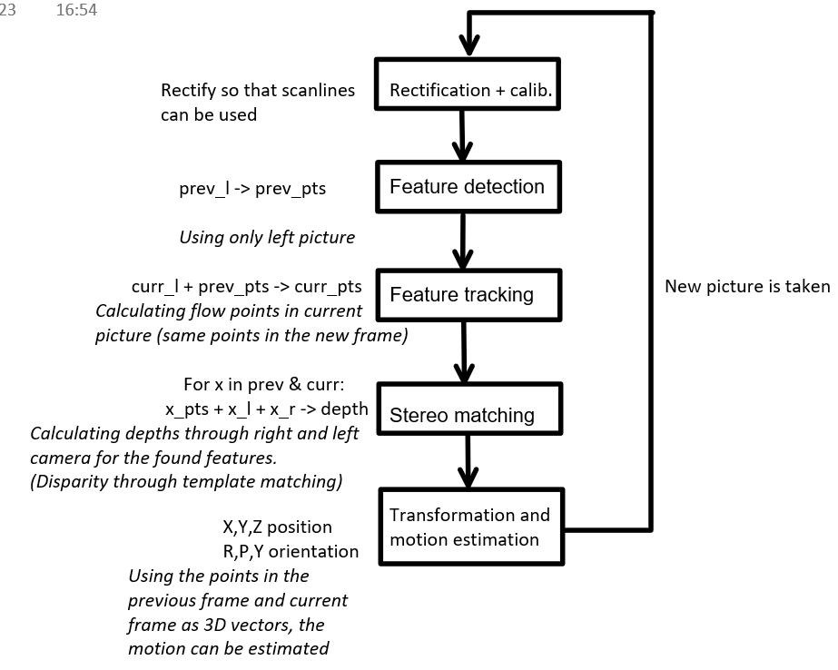
Overview

Slide 4
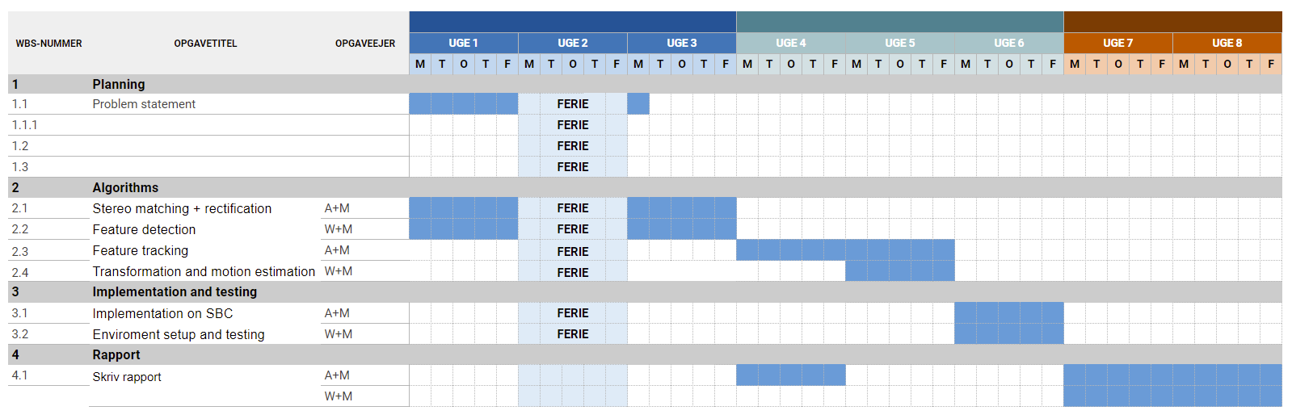
TimeLine

Slide 5
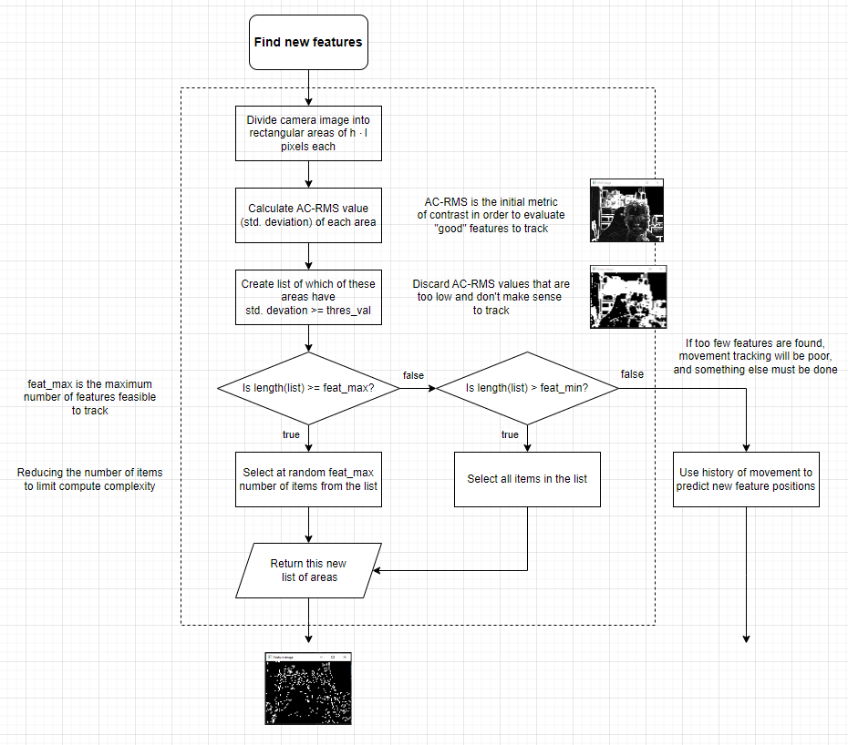
Feature detection

Slide 6
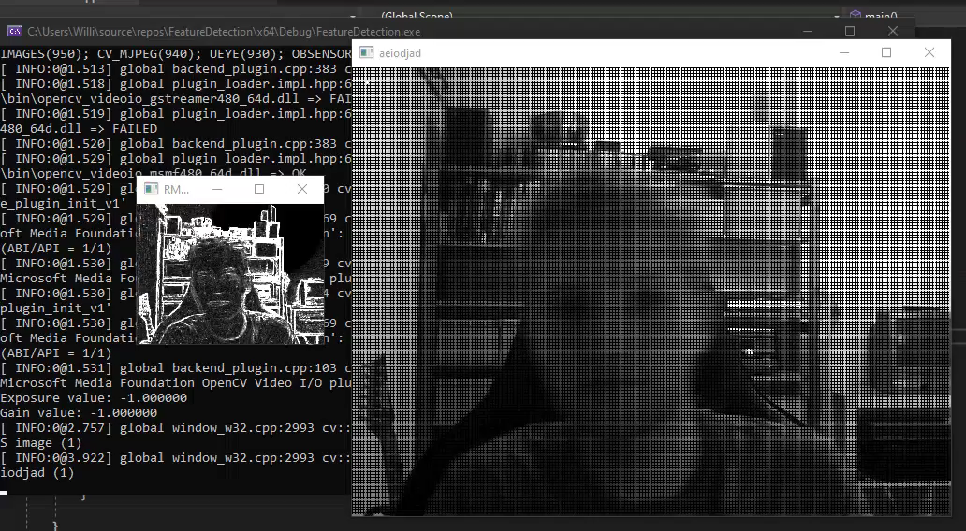
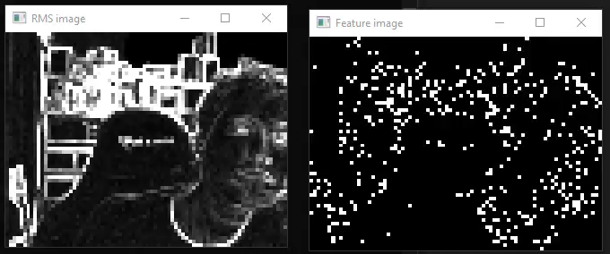

Slide 7

Questions

Slide 8
